Slide 1


Data Structure
Dr Swati Gupta & Ms Suman
Faculty
School of Engineering & Technology
K.R. Mangalam University
Unit 4 : Sorting and Searching

Slide 2


HEAP SORT
Heap Data Structure
Heap Types
Building a Heap
Example of Heap Sort
Algorithm of Heap Sort
Complexity Analysis of Heap Sort
Brainstorming Session

Slide 3
RECAP
In Selection Sort each of its iterations, it finds the smallest/largest element in the unsorted sub array and moves it to the sorted sub array.
It operates by maintaining a partition of the given array into the
following two arrays, at any point:
The subarray which is already sorted.
The remaining subarray, which has yet not been sorted.

Slide 4
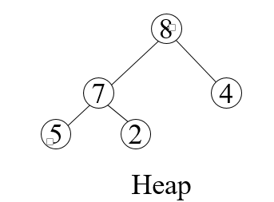
Heap Data structure
Heap is a nearly complete binary tree with the following two
properties:
Structural property: all levels are full, except possibly the last
one, which is filled from left to right
Order (heap) property: for any node x
Parent(x) ≥ x
From the heap property, it follows
that:
“The root is the maximum element of the heap!”

Slide 5
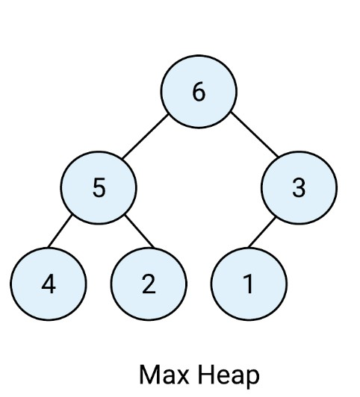
Heap Types
Max-heaps (largest element at root), have the max-heap property:
for all nodes i, excluding the root:
A[PARENT(i)] ≥ A[i]

Slide 6
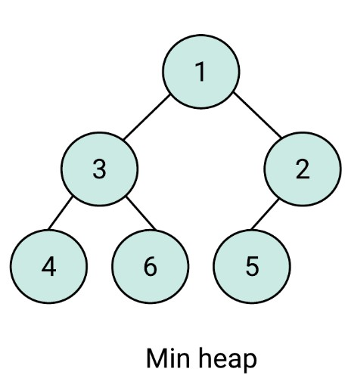
Heap Types
Min-heaps (smallest element at root), have the min-heap
property:
for all nodes i, excluding the root:
A[PARENT(i)] ≤ A[i]

Slide 7
Heap Sort
Heap Sort is an efficient sorting technique based on the heap data
structure.
The concept of heap sort is to eliminate the elements one by one
from the heap part of the list, and then insert them into the sorted part of the list.
Heapsort is the in-place sorting algorithm.
https://visualgo.net/en/sorting?slide=1
[Refer the link for better understanding of Heap Sort]

Slide 8

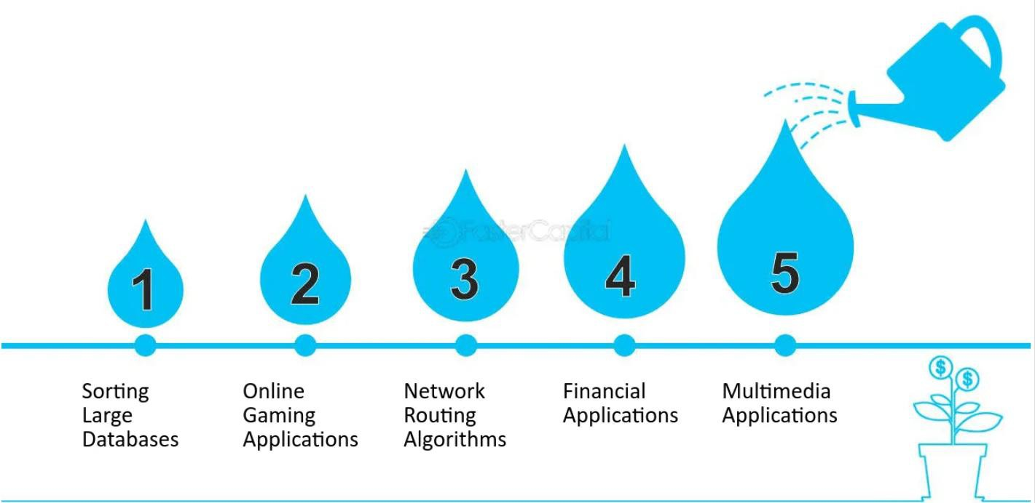
Real World Applications of Heap Sort

Slide 9
Steps Involved In Heap Sort
If it is about the max heap, then the highest element is stored at the root node.
Swap: Extract the root element and we need to place the last
element of the tree (heap) at the vacant place.
Remove: Reduce the size of the heap by 1.
Heapify: Heapify the root element again so that we have the highest element at root.
The process is repeated until all the items of the list are sorted.

Slide 10
Building up to heap
How to build a heap
How to maintain a heap
How to use a heap to sort data

Slide 11
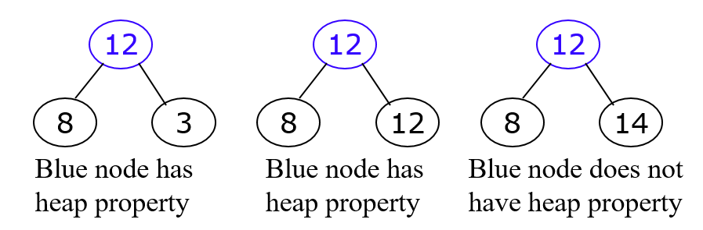
The Heap Property
A node has the heap property if the value in the node is as large as
or larger than the values in its children

Slide 12
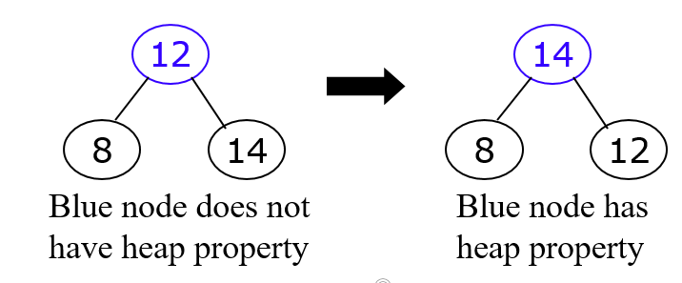
SiftUp Operation
Given a node that does not have the heap property, you can give it the heap property by exchanging its value with the value of the larger child.
This is sometimes called sifting up

Slide 13
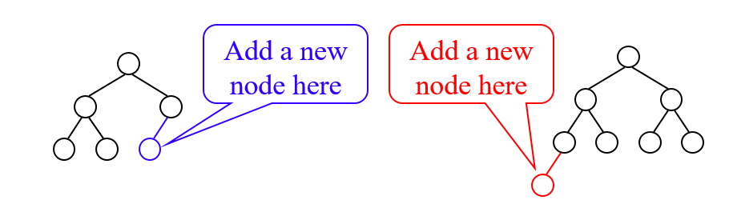
Constructing a Heap
A tree consisting of a single node is automatically a heap
We construct a heap by adding nodes one at a time:
Add the node just to the right of the rightmost node in the deepest level
If the deepest level is full, start a new level

Slide 14

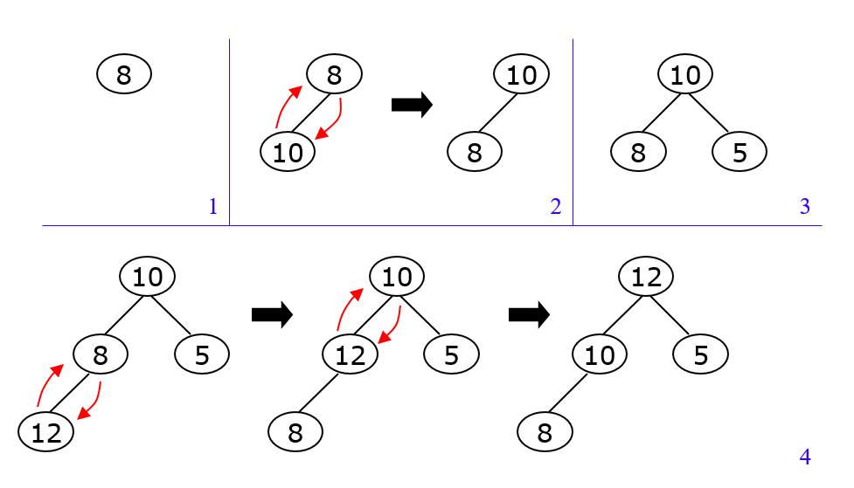
Constructing a Heap

Slide 15
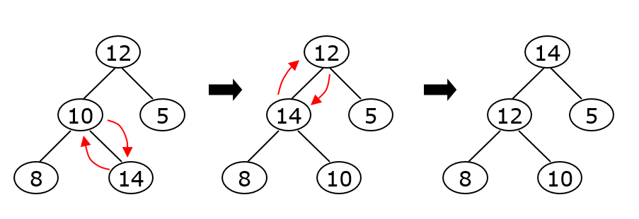
Constructing a Heap

Slide 16

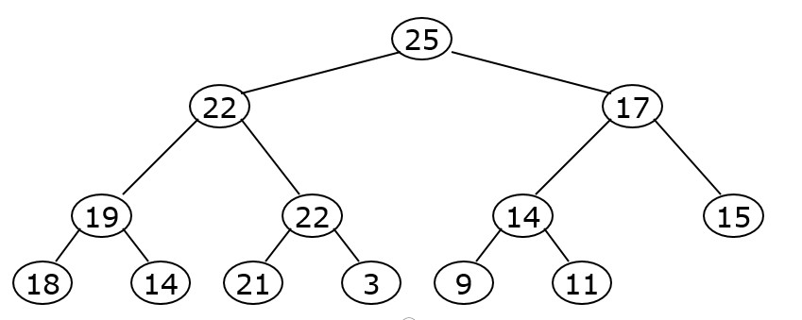
A sample heap
Here’s a sample binary tree after it has been heapified
Heapified does not mean sorted

Slide 17

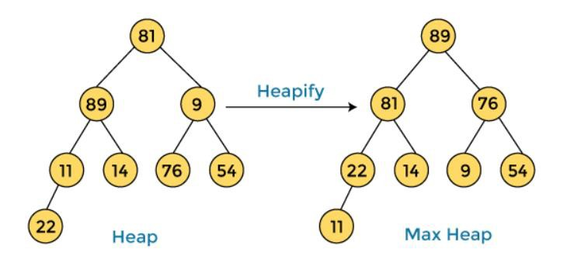
A sample heap

Slide 18
A sample heap
Here’s a sample binary tree after it has been heapified
Heapified does not mean sorted

Slide 19
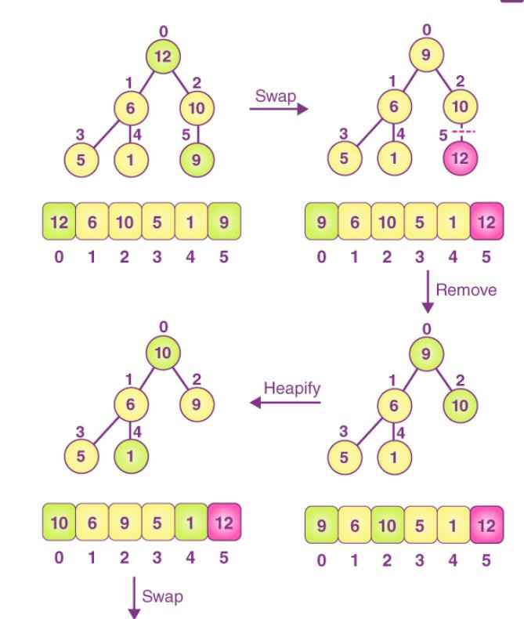
Example of Heap Sort
Consider an array having elements:12,6,10,5,1,9

Slide 20

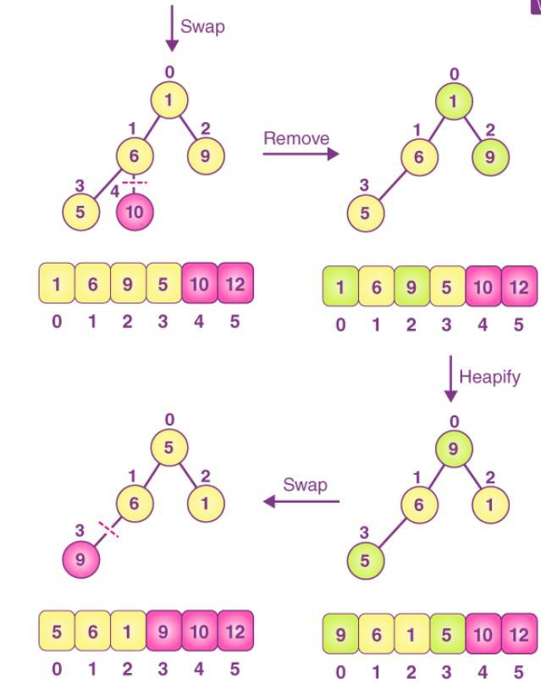
Example of Heap Sort

Slide 21
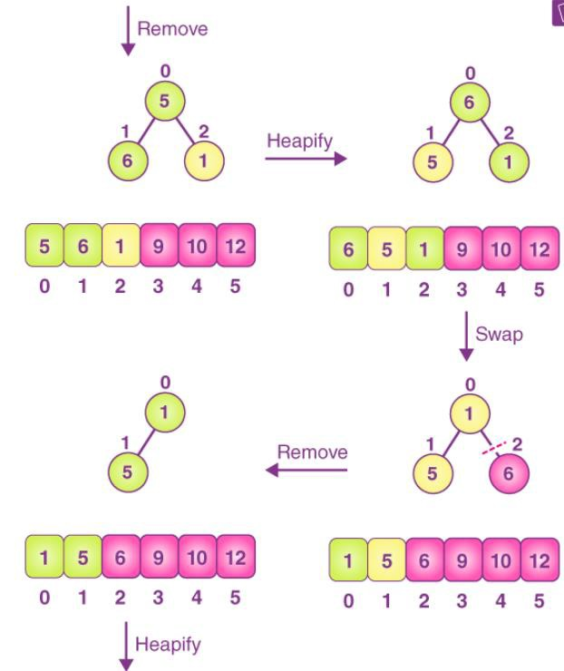
Example of Heap Sort

Slide 22
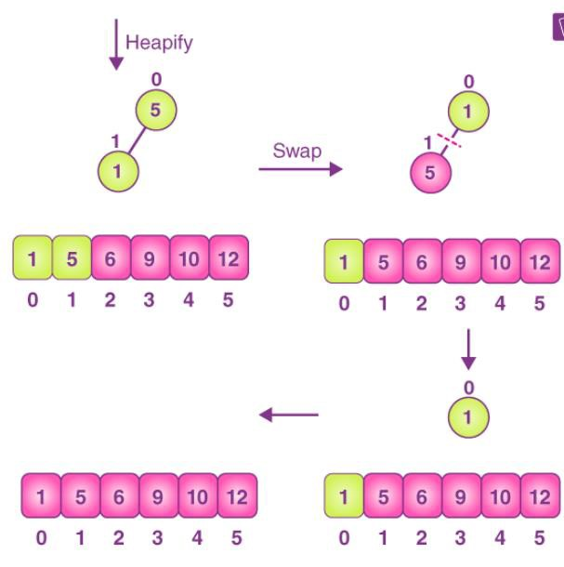
Example of Heap Sort

Slide 23
Exercise of Heap Sort
Consider an array having elements: 16, 10, 15, 9, 5, 12, 14.
Sort the following Elements using Heap Sort

Slide 24
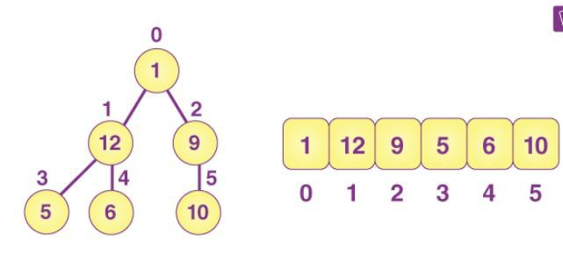
Heapify Operation Algorithm
Step 1:L=leftchild(i) Step 2:R=rightchild(i)
Step 3:If arr[L] > arr[i] and
heapsize>1
largest=L
Step 4: If arr[R]>arr[largest] and heapsize>1
largest=R
Step 5: If (i) is not the largest:
swap(arr[i], largest)

Slide 25

Heap Sort Algorithm Complexity Analysis
Time Complexity of the heapify() Method = O(log n).
Total Time Complexity of the Heap Sort = O(nlog n).

Slide 26
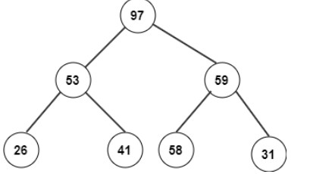
Test Your Knowledge
Q1 Consider the following heap after buildheap phase. What will be its corresponding array?
26,53,41,97,58,59,31
26,31,41,53,58,59,97
26,41,53,97,31,58,59
97,53,59,26,41,58,31
Answer (A)

Slide 27
Test Your Knowledge
Q2In heap sort, after deleting the last minimum element, the array will contain elements in?
increasing sorting order
decreasing sorting order
tree inorder
tree preorder
Answer (B)
Q3 What is the typical running time of a heap sort algorithm?
O(N)
O(N log N)
O(log N)
O(N²)
Answer (B)

Slide 28
Test Your Knowledge
Q4 What is the average number of comparisons used in a heap sort algorithm?
N log N-O(N)
O(N log N)-O(N)
O(N log N)-1
2N log N + O(N)
Answer (D)
Q5 Which one of the following is false?
Heap sort is an in-place algorithm
Heap sort has O(nlogn) average case time complexity
Heap sort is stable sort
Heap sort is a comparison-based sorting algorithm Answer (C)

Slide 29

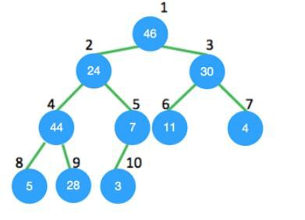
Test Your Knowledge
Q6 The essential part of Heap sort is construction of max-heap. Consider the tree shown below, the node 24 violates the max-heap property. Once heapify procedure is applied to it, which position will it be in?
a) 4
b) 5
c) 8
d) 9
Answer (D)

Slide 30
Test Your Knowledge
Q7 The descending heap property is
A[Parent(i)] = A[i]
A[Parent(i)] <= A[i]
A[Parent(i)] >= A[i]
A[Parent(i)] > 2 * A[i]
Answer (C)
Q8 Heap sort is an implementation of using a descending priority queue.
insertion sort
selection sort
bubble sort
merge sort
Answer (B)

Slide 31
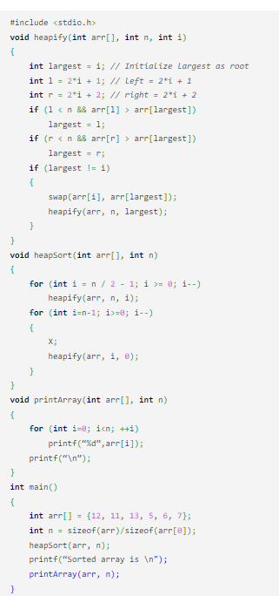
Test Your Knowledge
Choose the correct option to fill? X so that the code given below implements the Heap sort.
swap(arr[0], arr[n])
swap(arr[i], arr[n])
swap(arr[0], arr[i])
swap(arr[i], arr[2*i])
Answer (C)

Slide 32
References
https://www.hackerearth.com/practice/algorithms/sorting/heap-sort/tutorial/
https://www.freecodecamp.org/news/most-asked-questions-about-heap-sort/
https://www.scholarhat.com/tutorial/datastructures/heap-sort-in-data-structures
https://www.scaler.com/topics/data-structures/heap-sort/
https://visualgo.net/en/sorting
https://www.youtube.com/watch?v=LbB357_RwlY&pp=ygUJaGVhcCBzb3J0
Dr. Swati, Ms Suman & Ms Neetu

Slide 33
REVIEW
Heap is a nearly complete binary tree with the following two properties:
Structural property: all levels are full, except
possibly the last one, which is filled from left to right
Order (heap) property: for any node x
Parent(x) ≥ x
Ms.Suman
Data Structure
Unit2

Slide 34

THANK YOU

